Slide 1
Middleware in Express.js

Slide 2
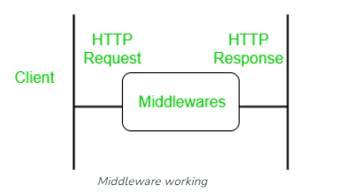
Middleware
Middleware functions are functions that have access to the request object (req), the response object (res), and the next middleware function in the application’s request-response cycle.
The next middleware function is commonly denoted by a variable named next.
Express-based application is a series of middleware function calls.

Slide 3
Middleware
Middleware functions can perform the following tasks:
Execute any code.
Make changes to the request and the response objects.
End the request-response cycle.
Call the next middleware function in the stack.
If the current middleware function does not end the request-response cycle, it must call next() to pass control to the next middleware function. Otherwise, the request will be left hanging.

Slide 4
Middleware Advantages
Middleware can process request objects multiple times before the server works for that request.
Middleware can be used to add logging and authentication functionality.
Middleware improves client-side rendering performance.
Middleware is used for setting some specific HTTP headers.
Middleware helps for Optimization and better performance.

Slide 5
Middleware Chaining
Middleware can be chained from one to another, Hence creating a chain of functions that are executed in order.
The last function sends the response back to the browser.
The next() function in the express is responsible for calling the next middleware function if exists.

Slide 6
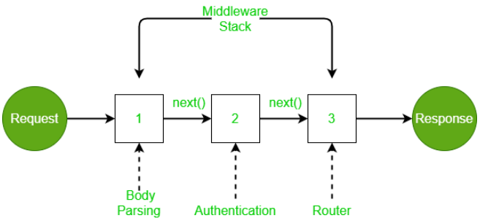
Middleware Chaining
Incoming request is modified and various operations are performed using several middlewares, and middleware is chained using the next function. The router sends the response back to the browser.

Slide 7
Middleware Syntax
The basic syntax for the middleware functions are as follows:
app.get(path, (req, res, next) => {}, (req, res) => {})
Middleware functions take 3 arguments: the request object, the response object, and the next function in the application’s request-response cycle, i.e., two objects and one function.

Slide 8
Middleware
Sample codes

